Slide 1
Research Proposal Writing
Prof. Nuwan Wickramasinghe
MBBS, Dip (OH&S), MSc (App. Epid.), MSc (Com. Med.), MD (Com. Med.), FRSPH
Board Certified Specialist in Community Medicine
Head | Chair Professor of Community Medicine
Rajarata University of Sri Lanka

Slide 2

Research

Slide 3
Research
“a process of systematic inquiry that entails collection of data; documentation of critical information; and analysis and interpretation of that data/information, in accordance with suitable methodologies set by specific professional fields and academic disciplines”

Slide 4
Research Question, Objective, and Hypothesis
Research question
A precise, focused, and answerable query that guides the entire study
E.g., What are the common pathogens and associated factors for surgical site infections in patients undergoing cardiac surgeries?

Slide 5
Research Question, Objective, and Hypothesis
Research objectives
Specific statements outlining what the study aims to achieve
They break down the research question into manageable components
E.g., To determine the common pathogens and associated factors with surgical site infections in patients undergoing cardiac surgeries

Slide 6
Research Question, Objective, and Hypothesis
Research hypothesis
A predictive statement about the expected relationship between variables
Testable through analysis
E.g., Patients with diabetes, obesity, or prolonged surgical duration are more likely to develop surgical site infections after cardiac procedures

Slide 7
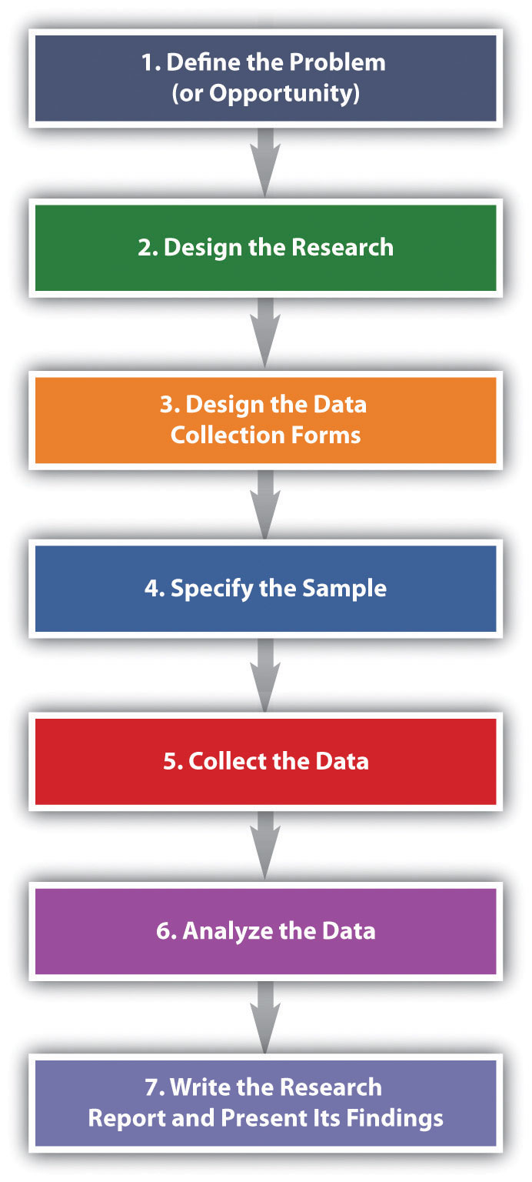
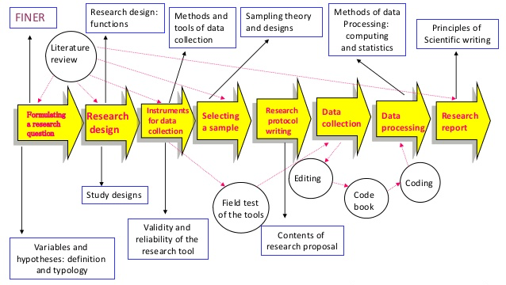
Research Process

Slide 8
Research Process
Identifying a research area
Reviewing existing knowledge/literature
Identifying a “gap” in research literature
Formulating hypothesis
Developing research objectives

Slide 9
Research Process
Selecting appropriate study methodology
Developing study tools/instruments
Developing research proposal
Obtaining ethical clearance
Obtaining administrative clearance

Slide 10
Research Process
Pre-testing / piloting
Collecting data
Analysing data
Interpreting data
Presenting study findings (dissemination)

Slide 11
Research Proposal
Title
Abstract
Introduction
- Background information
- Justification
- Objectives (General and Specific)
Literature review

Slide 12
Research Proposal
Methods
- Study design
- Study setting
- Study period
- Study population (inclusion/exclusion criteria)

Slide 13
Research Proposal
Methods
- Sample size calculation
- Sampling technique
- Study instruments
- Study implementation
- Plan for data analysis

Slide 14
Research Proposal
Administrative clearance
Quality of data
Ethical considerations

Slide 15
Title
Be concise but informative.
Reflect the scope of the study.
Include the main variable(s), population, and location.
Make the general objective clear.
Avoid abbreviations.

Slide 16
Title - Common Mistakes
Too long or wordy
❌ A study exploring patterns, frequency, and peer influence related to alcohol and substance use among university students in Sri Lanka to provide detailed insights for interventions
✅ Alcohol and substance use among university students in Sri Lanka: Patterns, determinants, and peer influence

Slide 17
Title - Common Mistakes
Does not reflect study scope
❌ Substance use in Sri Lanka
✅ Prevalence and associated factors of alcohol and substance use among first-year students at … University, Sri Lanka

Slide 18
Abstract
A mini version of the proposal.
Summarise background, objectives, methods, (main results, and conclusions).
Write it last, after completing the proposal.

Slide 19
Writing a Clear Abstract
Structured Vs. unstructured.
Always refer the guidelines, esp. word count.
Introduction, Objective/s, Methods, (Results, Conclusion).

Slide 20
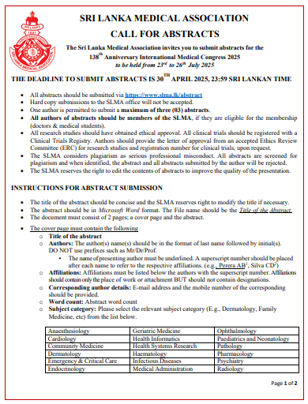
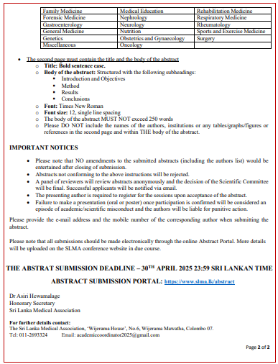

Slide 21
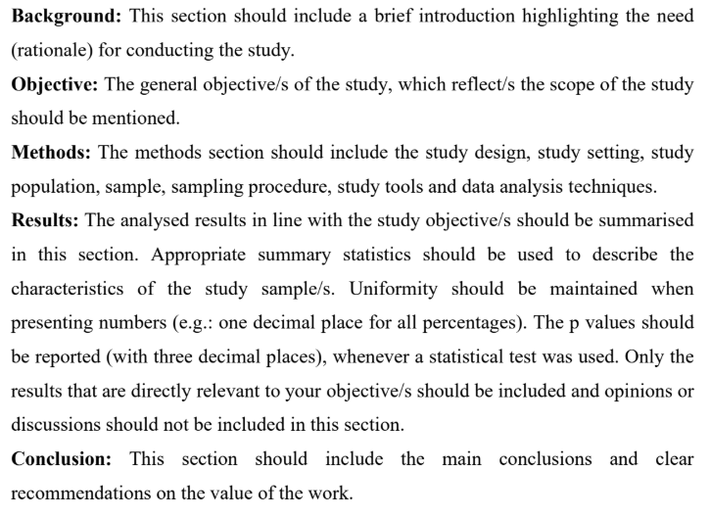
Abstract

Slide 22
Abstract - Common Mistakes
Not having all sections
❌ Only focus on one aspect
✅ Need to reflect all main aspects of the study
Not written properly
❌ Copy pasting several sentences from the report
✅ Meaningfully and logically rephrase each section

Slide 23
Introduction
Start broad and narrow down to the research problem.
Include background, justification (rationale), and existing evidence.
End with the objectives.

Slide 24
Background information
Define the research problem (central concept of the study).
Describe the nature of the problem (magnitude and associations).
Summary of what is already known.

Slide 25
Justification
Convincing argument for the need of the study.
Based on the knowledge/literature gaps.
Usefulness of the study findings.
How the potential findings will help to address evidence gaps, improve service delivery, promote health.

Slide 26
Objectives
General and Specific.
Should be clearly phrased in operational terms using action verbs.
- determine - assess
- estimate - evaluate
- describe - explore
Indicating what is done, where (study area/setting) and on whom (study population).

Slide 27
Objectives
General objective: broad statement of what is to be achieved at the end of the study.
Specific objectives: should cover all aspects included in the general objective in a logical and a sequential manner.

Slide 28
Objectives
General objective
A broad statement of what is to be achieved at the end of the study
Should reflect the full scope of the proposed study
E.g., To determine the clinical characteristics, treatment modalities, and clinical outcomes of patients with hyperparathyroidism followed up at Endocrine Clinics, National Hospital, Colombo

Slide 29
Objectives
Specific objectives
Logical and sequential breakdown of the general objective
E.g., 1. To describe the clinical characteristics …
2. To describe the treatment modalities …
3. To assess the clinical outcomes …
(of patients with hyperparathyroidism followed up at Endocrine Clinics, National Hospital, Colombo)

Slide 30
General Objective - Common Mistakes
Too broad or vague
❌ To study smoking pattern in Sri Lanka
✅ To determine the prevalence and associated factors of smoking pattern among school-going adolescents in the Gampaha District
Including methods instead of aims
❌ To use a questionnaire to collect data on ...
✅ To determine the factors associated with ...

Slide 31
General Objective - Common Mistakes
Simply rephrasing the title without adding value
❌ To study the prevalence and associated factors of alcohol use among youth
✅ To determine the prevalence of alcohol use and associated factors among youth in District X
Inappropriate action verbs
❌ To understand the prevalence of …
✅ To estimate the prevalence of …

Slide 32
Specific Objectives - Common Mistakes
Too many or too few objectives
✅ usually, 3–5 specific objectives
Overlapping or repetitive objectives
General objective: To describe the prevalence and associated factors of
substance use among youth in …
❌ 1. To estimate the prevalence of substance use in male ….
2. To estimate the prevalence of substance use in female ….

Slide 33
Specific Objectives - Common Mistakes
Specific objectives that go beyond (additional to) the general objective
General objective: To determine the prevalence and associated factors of
smoking pattern among school-going adolescents in the Gampaha District
✅ To estimate the prevalence of smoking pattern …
✅ To determine the associated factors of smoking pattern …
❌ To assess the effectiveness of an intervention to reduce the smoking …

Slide 34
Specific Objectives - Common Mistakes
Describing the sample characteristics as a separate specific objective
❌ To describe the socio-demographic profile of school-going adolescents in the Gampaha District
✅ Include as an integral component of the results section

Slide 35
Literature Review
‘Review’; not a mere summary.
In accordance with study objectives.
Global, regional and local studies.
Compare and contrast findings.
In-text citations.
Critical assessment.

Slide 36
Literature Review - Common Mistakes
❌ Copy paste the content
✅ Paraphrase retaining the meaning
❌ Include both relevant and irrelevant evidence
✅ In line with the objectives
❌ No logical order
✅In accordance with specific objectives, narrow down from global, regional to local, chronological order

Slide 37
Literature Review - Common Mistakes
❌ Mere reporting
✅ Critical assessment of the quality of evidence, strengths and limitations, relevance to the present study
❌ No updated evidence/only the recent evidence
✅ Need to have a balance, how the evidence evolved
❌ Missing/wrong references
✅In-text citations as per the guidelines

Slide 38
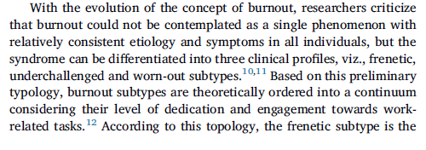
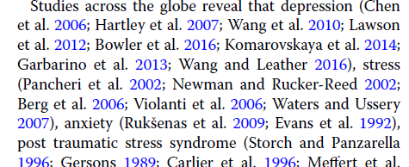
Literature Review
In-text citation
Vancouver Style
Uses numbered citations in the order they appear
Reference list arranged numerically
Harvard Style
Uses author-date in-text citations
Reference list arranged alphabetically

Slide 39
Methods
Study design
Study setting
Study period
Study population
Application of “Inclusion” and “Exclusion” criteria or both

Slide 40
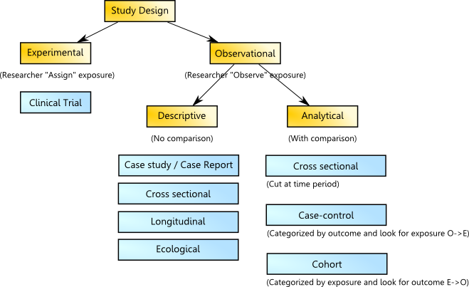
Study Design

Slide 41
Selecting a Study Design
To describe rare or unusual cases or novel occurrences (diseases, management, events following treatment)
Case report / Case series
To assess the prevalence of a condition at a single point in time
Cross-sectional study (if associations +: analytical component)

Slide 42
Selecting a Study Design
To study rare outcomes or diseases retrospectively to assess multiple risk factors
Case-control study
To assess incidence of an outcome over time/To assess multiple outcomes of a given exposure
Cohort study

Slide 43
Selecting a Study Design
To observe changes or trends in individuals or groups over time
Longitudinal study
To explore population-level associations using grouped data
Correlational study

Slide 44
Selecting a Study Design
To test the effectiveness or efficacy of an intervention by randomly assigning participants to groups
Randomised-controlled trial
When randomisation is not possible, but intervention and comparison groups are still studied
Non-randomised controlled trial (quasi-experimental)

Slide 45
Selecting a Study Design
To estimate the prevalence of anaemia among pregnant women attending antenatal clinics in …
To assess the relationship between national per capita sugar consumption and diabetes prevalence across South Asian countries
To evaluate the effectiveness of a new insulin analogue compared to standard insulin in controlling HbA1c levels in adults with type 2 diabetes
To assess long-term complications in patients with diabetes mellitus caused by Escherichia coli infections attending diabetic clinics in …

Slide 46
Selecting a Study Design
To describe a rare case of necrotising fasciitis caused by Vibrio vulnificus in a diabetic patient
To assess the prevalence and associated factors of obesity among school-going adolescents in …
To assess the impact of a school-based nutrition programme on body mass index among primary schoolchildren in two comparable schools
To determine risk factors associated with surgical site infections following CABG surgery at …

Slide 47
Study Design - Common Mistakes
Not naming the study design
❌ Data were collected from patients attending the clinic.
✅ A descriptive cross-sectional study was conducted among...
Choosing an inappropriate design for the objective
❌ Using cross-sectional design to establish causality
✅ Use cohort or case-control to determine risk factors; RCT for interventions
Inconsistency between design stated and methods used
❌ Stating “cohort study” but collecting data at a single time point
✅ Ensure stated design matches actual data collection approach

Slide 48
Study Setting
Study Setting: Describe WHERE the study was conducted
Include facility type, location, and relevant context
✅ “The study was conducted at the Teaching Hospital, Kandy - a tertiary care centre serving a catchment population of approximately 1.5 million in the Central Province, Sri Lanka.”

Slide 49
Study Period
Study Period: Include WHEN data were collected (not when the study was planned)
✅ “Data were collected over a period of three months from 1st January to 31st March 2024.”
❌ “The study was conducted at a hospital.” (too vague)
❌ Stating only the year without specifying months

Slide 50
Study Setting and Study Period - Common Mistakes
Vague or incomplete description of study setting
❌ The study was conducted in a hospital in Sri Lanka.
✅ The study was conducted at Base Hospital Chilaw, a secondary care
facility serving the Puttalam District with a daily OPD attendance of ~400.
Confusing study period with the overall project timeline
❌ The study was conducted from January 2023 to December 2024.
✅ Data were collected from June to August 2024.

Slide 51
Eligibility criteria - Common Mistakes
Exclusion criteria → not simply the opposite of inclusion criteria
Exclusion → refer to individuals who would otherwise meet the inclusion criteria, but are deliberately not included for specific reasons
E.g., School going adolescents aged 15-18 years in the Gampaha District
aged >18 years ❌
outside Gampaha District❌
out-of-school adolescents❌

Slide 52
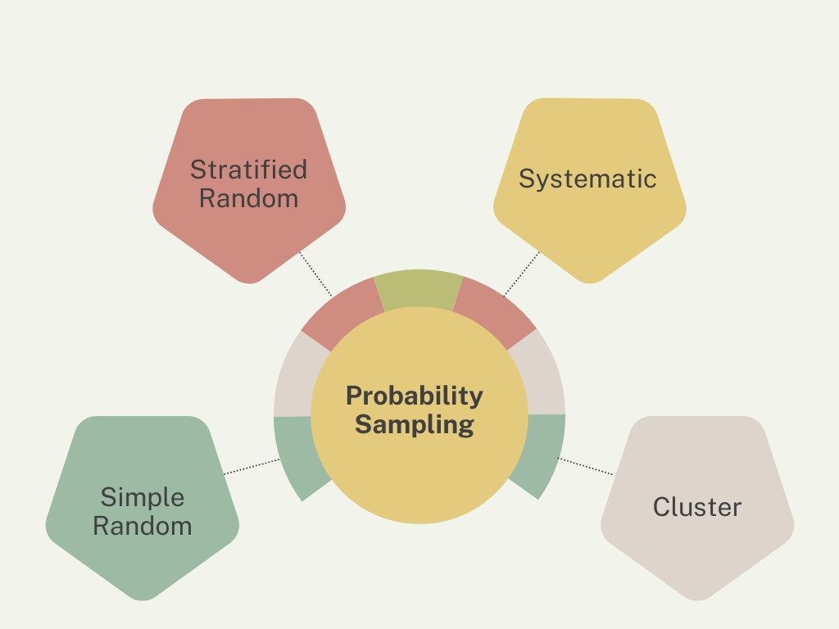
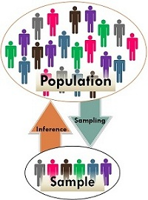
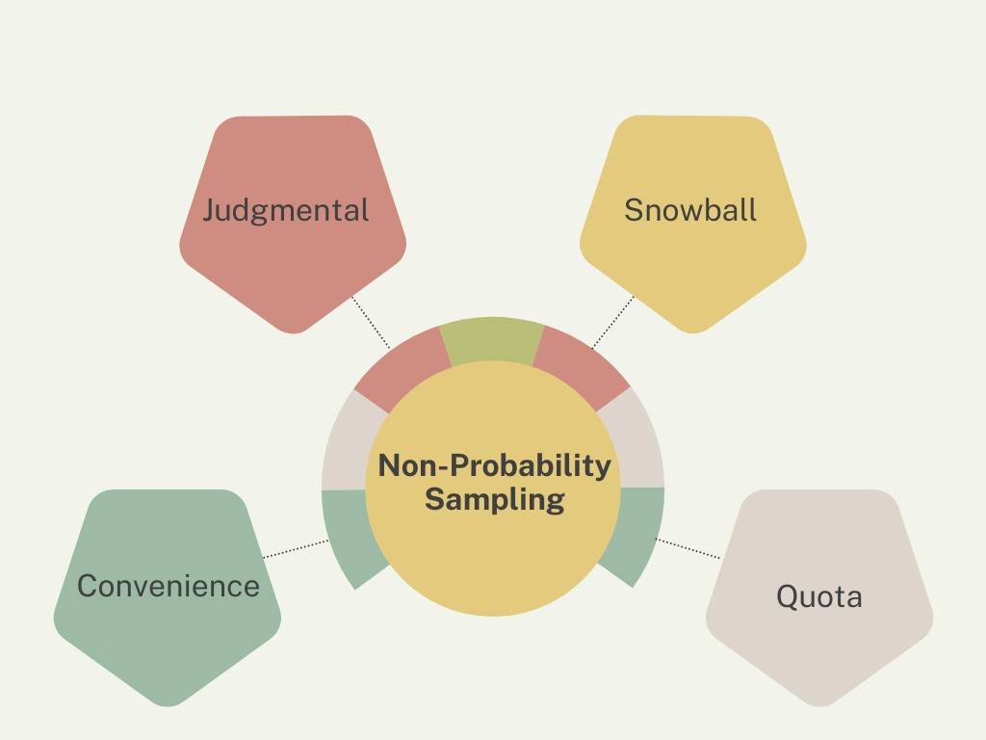
Methods
Sample size calculation
Sampling technique

Slide 53
Sample Size Calculation
Always calculate a minimum required sample size - never guess
State the formula used and ALL parameters.
Always cite the reference used to obtain the prevalence estimate for calculation
If no local data: use 50% (most conservative) for prevalence-based calculations

Slide 54
Sample Size Calculation
Recommended Free Software/Online Calculators
OpenEpi (www.openepi.com) - prevalence, case-control, cohort studies
G*Power (www.gpower.hhu.de) - regression, ANOVA, t-tests
- StatCalc in Epi Info (wwwn.cdc.gov/epiinfo/) - epidemiological studies

Slide 55
Sample Size Calculation
✅ E.g., Cross-sectional, prevalence study
“Using the formula n = z²p(1-p)/d² with an estimated prevalence of
30.4% (Ref.), z=1.96, margin of error 5%, and a 10% non-response rate,
a minimum sample of 348 participants was required.”

Slide 56
Sample Size Calculation - Common Mistakes
Not calculating a sample size
❌ The sample size was 100.
✅ For any study, minimal number of subjects to be recruited
Inadequate details/Incorrect formula
❌ Sample size was calculated using an online software.
✅The method used to calculate, if relevant formula, details of estimates used

Slide 57
Sampling Technique
Match sampling to study design and population structure
Probability sampling: preferred for generalisability
Simple random | Systematic | Stratified | Cluster | Multi-stage
Non-probability: when random sampling not feasible
Consecutive | Purposive | Snowball (used in qualitative studies)
Always describe the sampling frame (the list from which you sampled)

Slide 58
Sample Size and Sampling - Common Mistakes
Incorrect sampling technique
❌ For all sampling - simple random sampling
✅Correct sampling - Probability Vs. Non-probability

Slide 59
Sampling Technique - Common Mistakes
Using simple random sampling for all studies without justification
❌ Simple random sampling was used to select 200 patients.
✅ Systematic random sampling was used; every 3rd patient attending the clinic was selected from the clinic register.
Not explaining HOW the sampling was done
❌ Stratified sampling was used.
✅ Stratified sampling by district (3 strata) was performed; within each stratum, participants were selected by proportionate simple random sampling.

Slide 60
Methods
Study instrument/s
  Questionnaires/Equipment/Laboratory methods/Procedure
  Development
  Pre-testing
Study implementation
  Data collection
  Training
  People involved
  Procedures

Slide 61
Study Instruments - Common Mistakes
Inadequate details
❌ A questionnaire was used to collect data.
✅ Self-administered questionnaire in Sinhala and Tamil languages, having two main sections including assessing the prevalence and associations of …
Not using validated questionnaires
❌ Used … developed in the United States.
✅ Validated and culturally adapted to the context to be used

Slide 62
Study Instruments - Common Mistakes
Cut-off values (E.g., KAP studies)
❌ Good and poor knowledge was determined by using a cut-off value.
✅ Methods used to determine the cut-off values, rationale (any previous evidence?)
Not describing the structure of the questionnaire
❌ A questionnaire was administered to participants.
✅ A 32-item self-administered questionnaire with three sections:
Section A: Socio-demographics (8 items); Section B: Knowledge (12 items,
scored 0-12); Section C: Practice (12 items, scored 0-12).

Slide 63
Methods
Data analysis
  according to study objectives
  statistical software
  statistical tests
  effect measure
  statistical significance

Slide 64
Data Analysis
Match statistical tests to data type and study objective
- Descriptive: frequencies, proportions, mean (SD), median (IQR)
- Comparison: Chi-square / Fisher’s exact (categorical); t-test / Mann-Whitney (continuous)
- Association: Odds ratio (case-control); Prevalence ratio (cross-sectional)
- Multivariable: Logistic regression (binary outcome); Linear regression (continuous)

Slide 65
Data Analysis
✅ “Data were entered and analysed using SPSS version 26.0. Frequencies and proportions were used to describe socio-demographic characteristics. Chi-square test was used to assess associations between categorical variables. Crude and adjusted odds ratios with 95% confidence intervals were calculated using binary logistic regression. Statistical significance was set at p<0.05.”

Slide 66
Data Analysis - Common Mistakes
Not specifying the statistical software version
❌ Statistical analysis was performed using SPSS.
✅ Data were analysed using IBM SPSS Statistics version 26.0 (IBM Corp., 2019).
Not describing data cleaning and management steps
✅ Mention double data entry, range checks, or validation procedures

Slide 67
Data Analysis - Common Mistakes
Stating the wrong test for the data type
❌ Independent t-test used for non-normally distributed data
✅ Mann-Whitney U test used as data were not normally distributed (Shapiro-Wilk p<0.05)
Not mentioning the level of statistical significance
✅ Always state: “Statistical significance was defined as p<0.05”

Slide 68
Ethical Issues
Specific to the study.
Measures taken to overcome.
Consent.
Maintenance of confidentiality.

Slide 69
Ethical Issues
Non discrimination.
Referral for further management.
Ethical clearance.

Slide 70

Consent
Informed consent
    Voluntariness
    Comprehension
    Disclosure of information
    Cultural sensitivity
    Capacity to consent
    Ongoing process
    Right to withdraw
    No penalty

Slide 71
Results
Present findings logically.
Only present what is relevant to the study.
Follow the order of objectives.
Use tables and figures to summarise data.
Avoid repetition between text and visuals.

Slide 72
Choosing Appropriate Summaries
Quantitative data → Mean (SD), Median (IQR), Proportions (CI)
Qualitative data → Themes, Illustrative quotes.

Slide 73
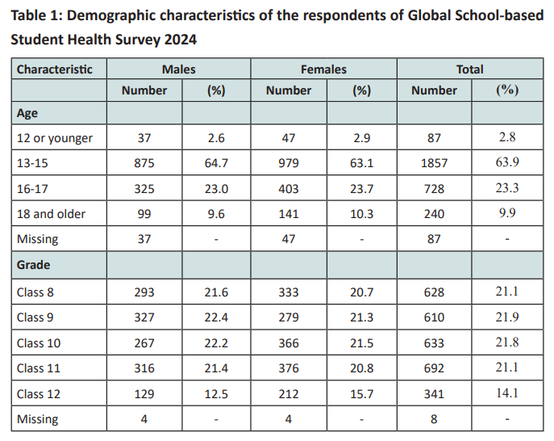
Using Tables Effectively
Each table should be self-explanatory.
Include titles, units, and footnotes.

Slide 74
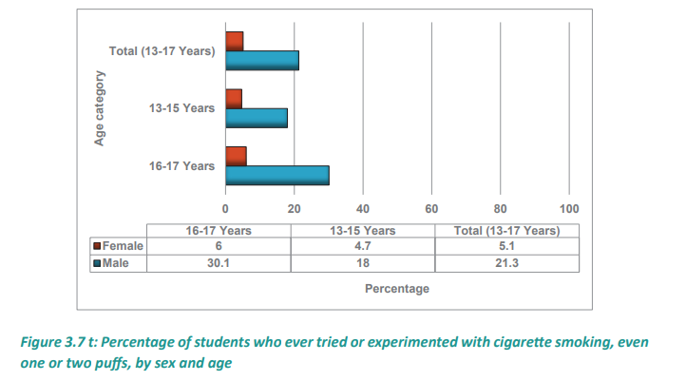
Visualising Results
Use bar graphs for categorical data, line graphs for trends, scatterplots for correlations.
E.g., Bar graph: Prevalence of smoking by year of study.
Line graph: Decline in alcohol use after intervention (baseline vs
follow-up).

Slide 75
Data Presentation - Common Mistakes
Lack of uniformity in reporting (E.g., decimal points)
❌ Prevalence of smoking among males and females were 24.1% and 11.321%.
✅ Prevalence of smoking among males and females were 24.1% and 11.3%.
p value
❌ p=0.000
✅ Usually, reported in 3 decimal points (p<0.001)

Slide 76
Data Presentation - Common Mistakes
Inadequate details in summary statistics
❌ Mean age 17.2 years, prevalence 24.1%
✅ Mean (SD) age 17.2 (2.1) years, prevalence 24.1% (95% CI=21.3%-27.1%)
Numbers with percentages and vice versa
❌ Of the participants, 57% were in grade 10 and 43% were in grade 11
✅ Of the participants, 56.9% (n=115) were in grade 10 and 43.1% (n=86) were in grade 11

Slide 77
Data Presentation - Common Mistakes
Mixing results with discussion
❌ The high prevalence of alcohol use shows the failure of policies.
✅ The prevalence of alcohol use was 33%, highest among first-year males.
Poor figure/table labelling
❌ Graph without title, units, or axes.
✅ Figure 1. Prevalence of substance use by age group (%)

Slide 78
Data Presentation - Common Mistakes
Repetition
❌ A table, figure as well as the text mention the prevalence of smoking among males and females repeatedly.
✅ Just the salient findings in the text and use either a table or a figure as appropriate.
Inappropriate graph choices
❌ Pie chart for time trends in alcohol use
✅ Line graph or clustered bar chart

Slide 79
Data Presentation - Common Mistakes
Ignoring missing data
❌ All respondents answered the alcohol use questionnaire.
✅ Data were available for 92% of participants; 8% missing values excluded.
Incorrect interpretations
❌ There was a significant difference (p=0.09).
✅ No statistically significant difference was observed (p=0.09).

Slide 80
Discussion
Summarise the main findings.
Interpret the findings.
Compare with previous studies.
Explain unexpected results.

Slide 81
Discussion
Highlight public health and policy implications.
Discuss strengths and limitations.
Suggest future research directions.

Slide 82
Discussion - Common Mistakes
Repeating results instead of interpreting
❌ The prevalence of smoking among male students was 28.2%, and among female students was 5.4%.
✅ The higher prevalence of smoking among males compared with females may reflect greater social acceptability and peer influence in male groups.
Overgeneralising findings
❌ Since smoking was common among students in our university, all universities in the country likely face the same issue.
✅ Comment on generalizability based on your methods.

Slide 83
Discussion - Common Mistakes
Making unsupported causal relationships
❌ Substance use causes poor academic performance among students.
✅ Substance use was associated with lower academic performance; however, as the study design was cross-sectional, causality cannot be established.
Ignoring study limitations
❌ Our results are valid for all students in the study setting.
✅ The study relied on self-reported data, which may be subject to reporting bias.

Slide 84
Conclusions and Recommendations
Summarise the main message of your study.
Need to provide answers to the objectives of the study.
Provide actionable recommendations supported by evidence.
Recommendations should be based on the study findings.

Slide 85
Conclusions - Common Mistakes
Vague or weak conclusions
❌ Substance use should be reduced.
✅ Findings indicate the need for school-based alcohol and substance use prevention programmes.
Not keeping conclusions within study context
❌ All universities in the country have the same substance use patterns.
✅ Findings reflect this university and therefore further studies are needed to assess other institutions.

Slide 86
Recommendations - Common Mistakes
Recommendations not indicating who should act and how.
❌ Research findings are important for policymakers.
✅ Findings indicate the need for school-based alcohol and substance use prevention programmes.
Not based on study findings.
❌ There should be school-based counselling programmes to address substance use and mental health issues like depression and anxiety.
✅ There should be school-based counselling programmes to address substance use.

Slide 87
References
Follow a consistent style.
  Harvard: author-date (e.g., Smith, 2020) in the text and an alphabetical list of references
  Vancouver: numbered citations in the text and a numbered list of references in order of appearance
Cite all sources accurately.
Avoid plagiarism.
According to the guidelines given.

Slide 88
Appendices
Include data collection tools, consent forms, ethics letters.
Include all relevant documents in appropriate languages.
No need to add unrelated appendices or annexes.

Slide 89
Writing Style
Use simple, clear language.
Avoid unnecessary technical terms.
Use consistent formatting style.
Adhere to correct use of abbreviations.
Always adhere to the given guidelines.

Slide 90
Revision and Editing
Proofread multiple times.
Seek peer/supervisor review before submission.

